Slide 1


Weekly Update
Leandro Catarci
Bachelor’s Thesis
06.05.2025
Date

Slide 2
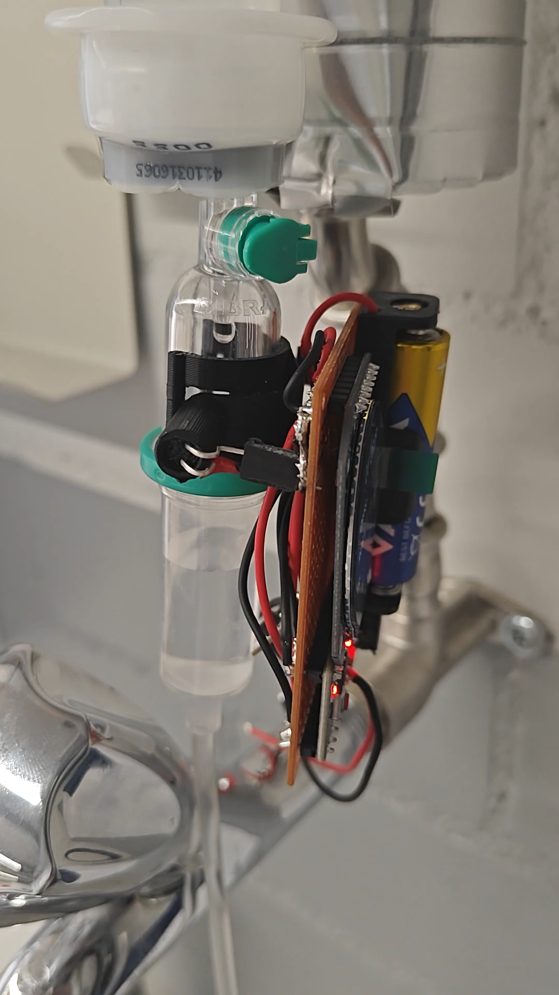

Slide 3
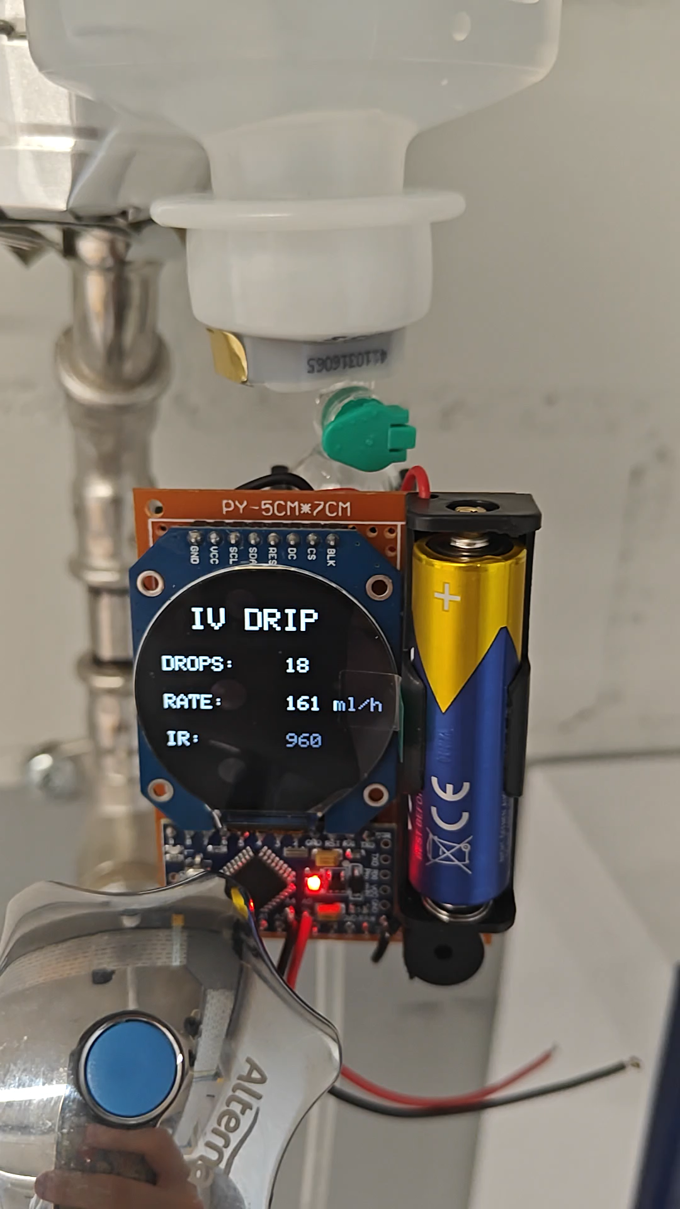

Slide 4
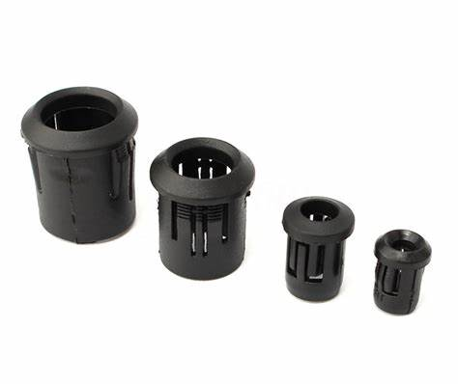

Slide 5
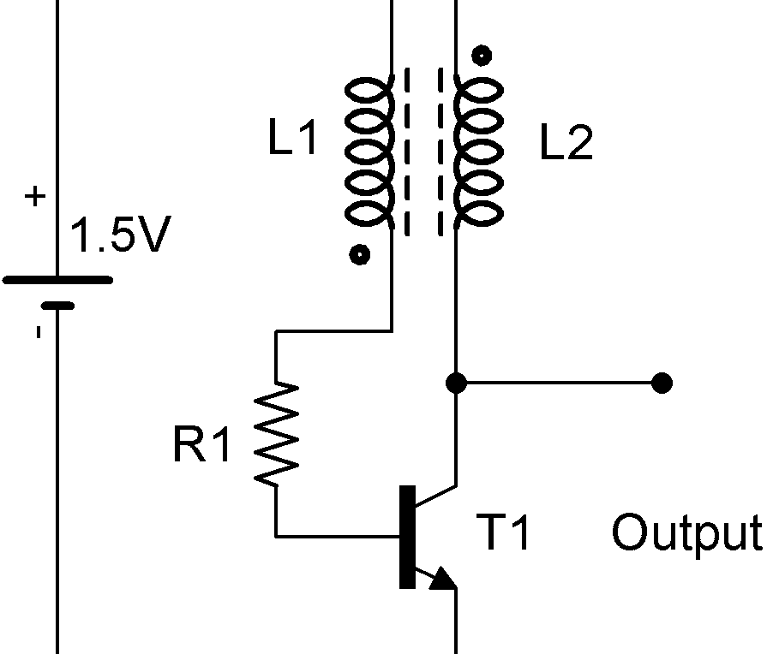

Slide 6


Slide 7
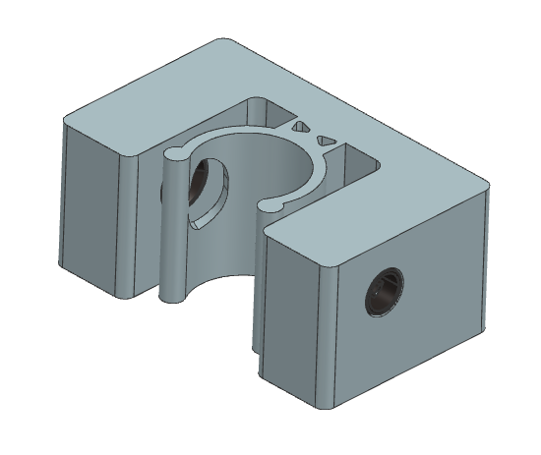

Slide 8
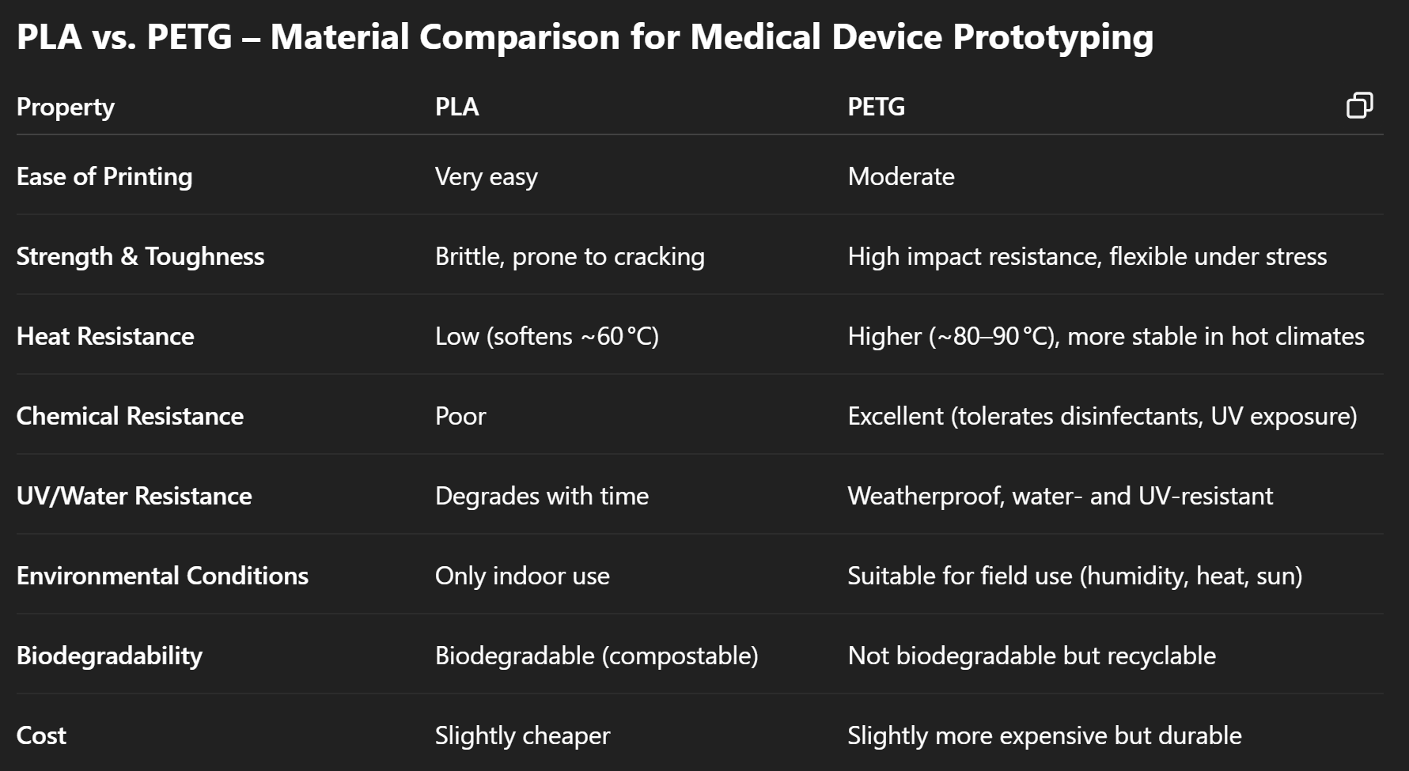

Slide 9
Current Blockers
Holder Mechanism - C-Clamp is optimized for my one drip chamber
Delivery Time LED Bezel
Lacking input from medical professionals

